Slide 1
Dictionaries

Slide 2
Objectives
What are dictionaries in Python?
What are Key Value Pairs?
How can KVPs be used to model objects?
How are dictionaries declared and used?

Slide 3
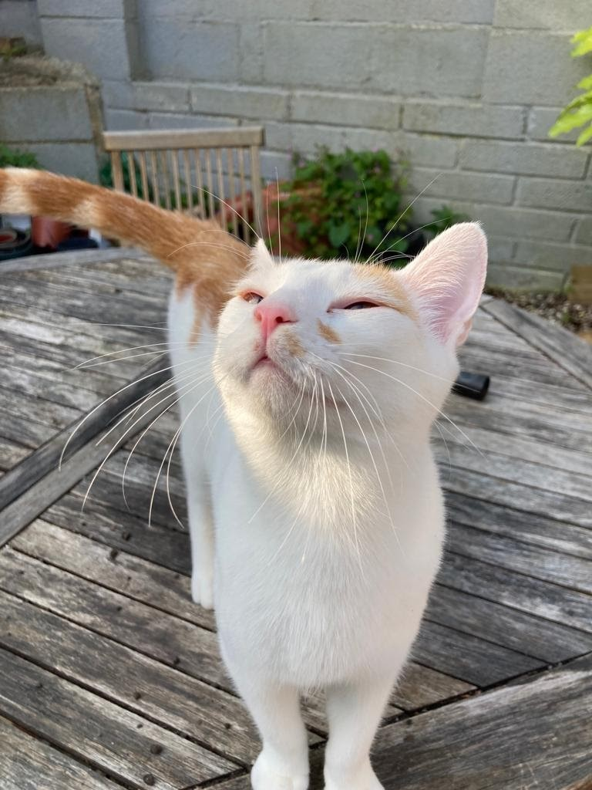

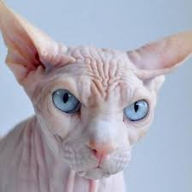
Weasley, Noche, and Mr. Bigglesworth…

Slide 4
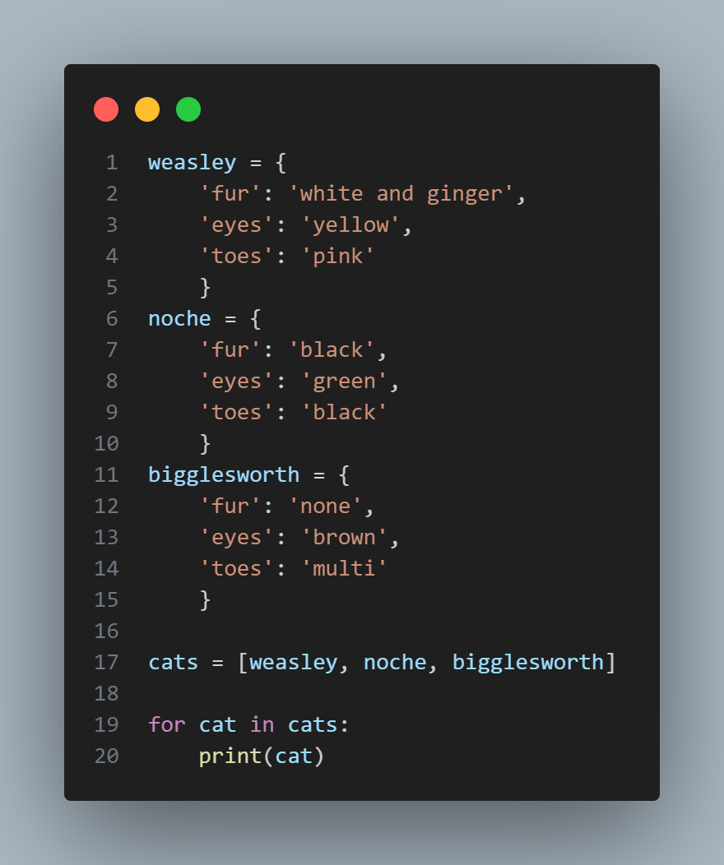
Notes:
weasley = {
'fur': 'white and ginger',
'eyes': 'yellow',
'toes': 'pink'
}
noche = {
'fur': 'black',
'eyes': 'green',
'toes': 'black'
}
bigglesworth = {
'fur': 'none',
'eyes': 'brown',
'toes': 'multi'
}
cats = [weasley, noche, bigglesworth]
for cat in cats:
print(cat)
What would happen if I ran this code? Take a guess, then we will break it down.

Slide 5
Introducing Dictionaries
Dictionaries work by using key value pairs. A key value pair is just a set of values that are associated with each other.
Dictionaries can store an almost limitless amount.
Represented using a curly bracket {}
Although the syntax is a little trickier, dictionaries are basically quite similar to lists. We can add, remove items, edit and retrieve keys, values, or both. We can also loop through our dictionaries just like lists.

Slide 6
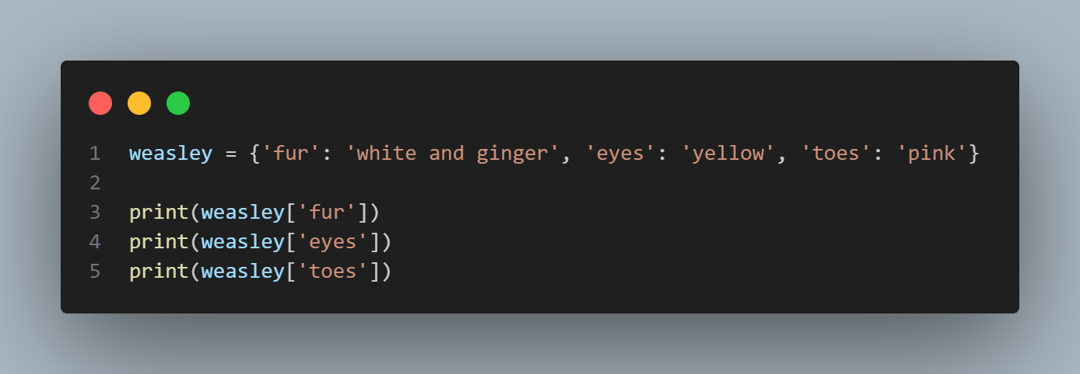
A Simple Dictionary
Syntax:
Dictionary_name = {‘key_name’: ‘value_name’, ‘key_name’: ‘value_name’}
Notes:
weasley = {'fur': 'white and ginger', 'eyes': 'yellow', 'toes': 'pink'}
print(weasley['fur'])
print(weasley['eyes'])
print(weasley['toes'])

Slide 7
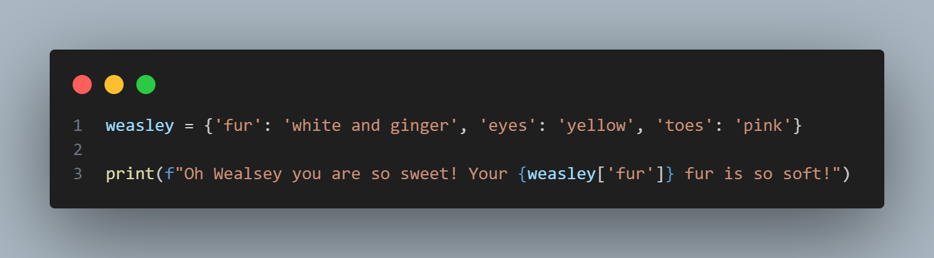
Access one of the values in the Dictionary
Syntax:
dictionary_name[‘key_name’]
Notes:
weasley = {'fur': 'white and ginger', 'eyes': 'yellow', 'toes': 'pink'}
print(f"Oh Wealsey you are so sweet! Your {weasley['fur']} fur is so soft!")

Slide 8
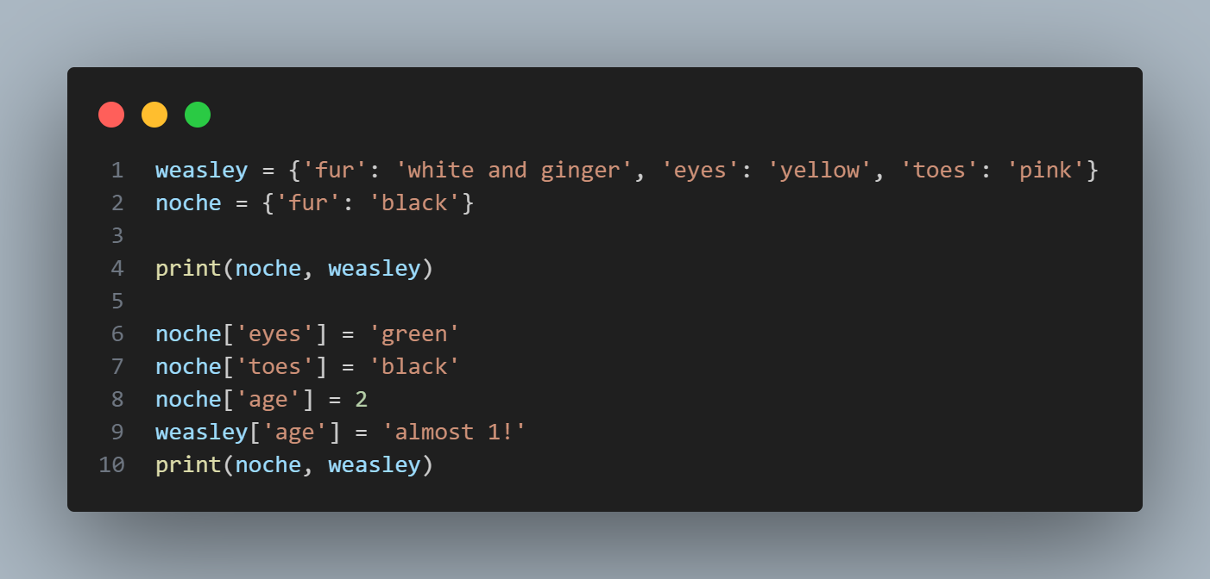
Add new key-value pairs
Syntax:
Dictionary_name[‘new_key’] = ‘new_value’
Notes:
weasley = {'fur': 'white and ginger', 'eyes': 'yellow', 'toes': 'pink'}
noche = {'fur': 'black'}
print(noche, weasley)
noche['eyes'] = 'green'
noche['toes'] = 'black'
noche['age'] = 2
weasley['age'] = 'almost 1!'
print(noche, weasley)

Slide 9
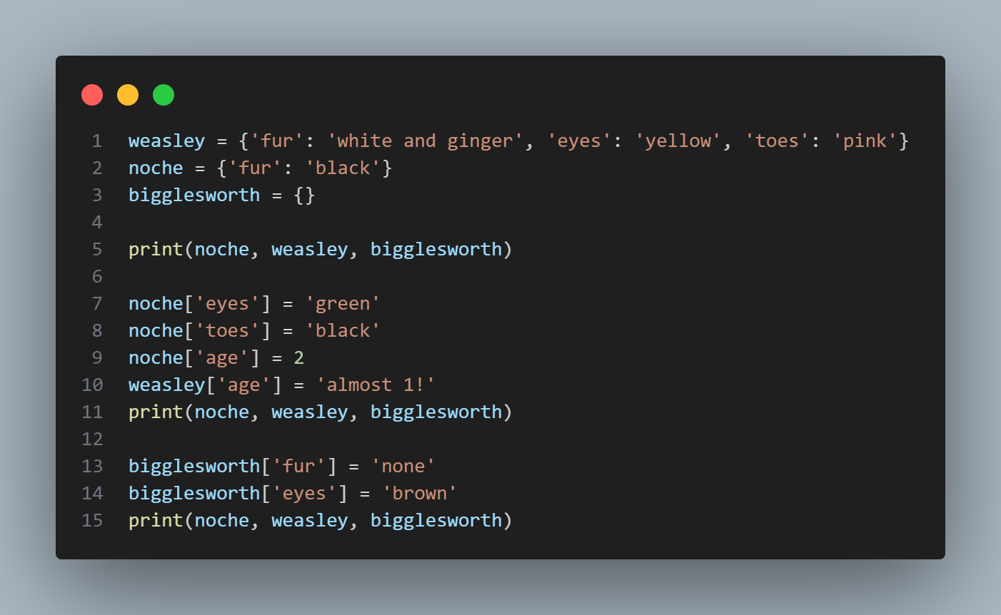
Empty Dictionaries
Notes:
weasley = {'fur': 'white and ginger', 'eyes': 'yellow', 'toes': 'pink'}
noche = {'fur': 'black'}
bigglesworth = {}
print(noche, weasley, bigglesworth)
noche['eyes'] = 'green'
noche['toes'] = 'black'
noche['age'] = 2
weasley['age'] = 'almost 1!'
print(noche, weasley, bigglesworth)
bigglesworth['fur'] = 'none'
bigglesworth['eyes'] = 'brown'
print(noche, weasley, bigglesworth)

Slide 10
Modifying values in a dictionary
Syntax:
Dicitonary_name[‘key_name_to_change’] = ‘value_name_to_change’
Example on next slide!
Notes:
weasley = {'fur': 'white and ginger', 'eyes': 'yellow', 'toes': 'pink'}
noche = {'fur': 'black'}
bigglesworth = {}
print(noche, weasley, bigglesworth)
#adding pairs into an existing dictionary
noche['eyes'] = 'green'
noche['toes'] = 'black'
noche['age'] = 2
weasley['age'] = 'almost 1!'
print(noche, weasley, bigglesworth)
#adding into an empty dictionary
bigglesworth['fur'] = 'none'
bigglesworth['eyes'] = 'brown'
print(noche, weasley, bigglesworth)
#modifying values in a dictionary
weasley['age'] = 1
print(weasley)
print(f"weasley just turned {weasley['age']}")

Slide 11
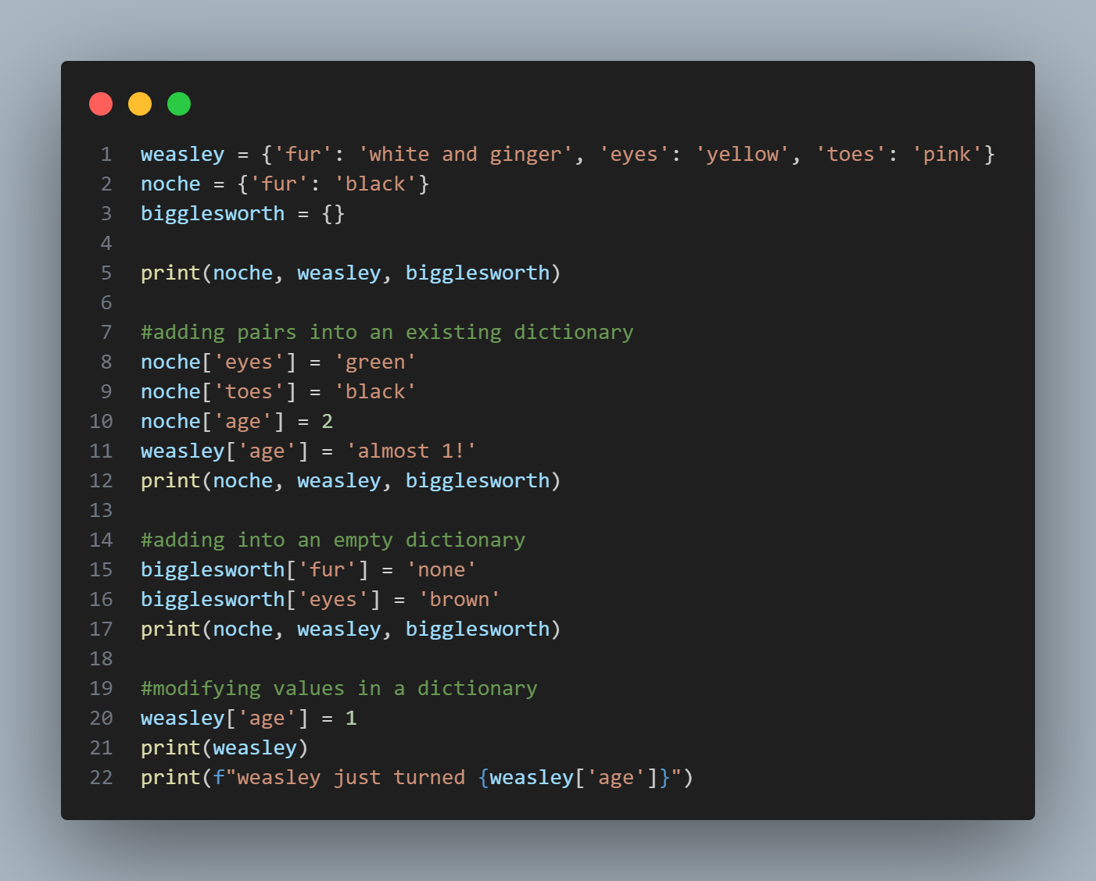

Slide 12
Removing key value pairs
Use del
Syntax:
Del dictionary_name[‘key_name’]
Example on next slide!
Notes:
weasley = {
'fur': 'white and ginger',
'eyes': 'yellow',
'toes': 'pink'
}
noche = {'fur': 'black'}
bigglesworth = {}
print(noche, weasley, bigglesworth)
#adding pairs into an existing dictionary
noche['eyes'] = 'green'
noche['toes'] = 'black'
noche['age'] = 2
weasley['age'] = 'almost 1!'
print(noche, weasley, bigglesworth)
#adding into an empty dictionary
bigglesworth['fur'] = 'none'
bigglesworth['eyes'] = 'brown'
print(noche, weasley, bigglesworth)
#modifying values in a dictionary
weasley['age'] = 1
print(weasley)
print(f"weasley just turned {weasley['age']}")
#deleting values in dictionaries
del weasley['age']
print(weasley)

Slide 13
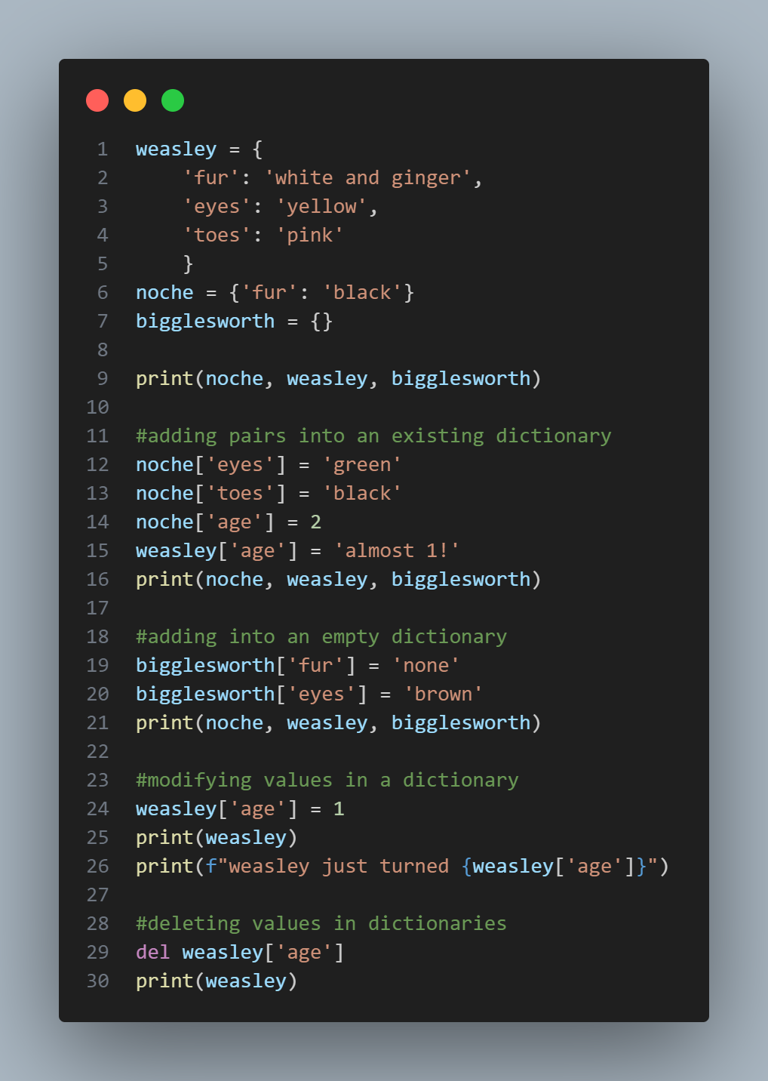

Slide 14
Using loops with Dictionaries
Notes:
weasley = {
'fur': 'white and ginger',
'eyes': 'yellow',
'toes': 'pink'
}
for key, value in weasley.items():
print(f"The key is {key}")
print(f"The value is {value}")

Slide 15
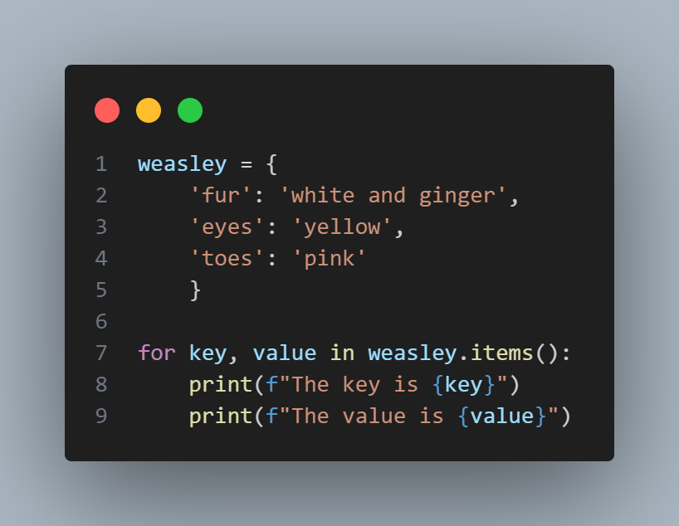

Slide 16
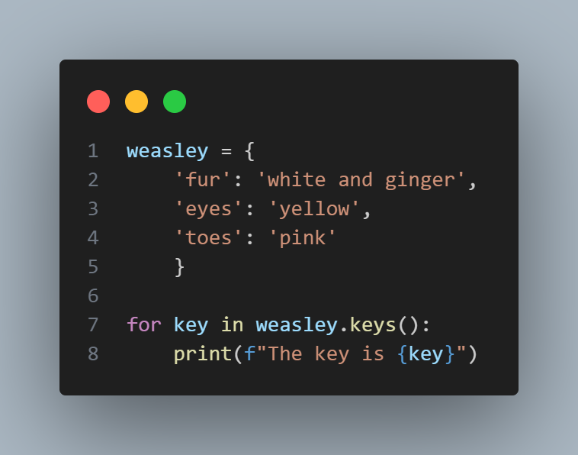
keys() and values()
.keys() for your keys
.values() for your values
Notes:
weasley = {
'fur': 'white and ginger',
'eyes': 'yellow',
'toes': 'pink'
}
for key in weasley.keys():
print(f"The key is {key}")

Slide 17
Using loops with Dictionaries
.items() - this allows us to view both the key and value in a dictionary
Syntax:
dictionary_name.items()
DO NOT FORGET YOUR COLON :
Example on next slide!
Notes:
weasley = {
'fur': 'white and ginger',
'eyes': 'yellow',
'toes': 'pink'
}
for key, value in weasley.items():
print(f"The key is {key}")
print(f"The value is {value}")

Slide 18
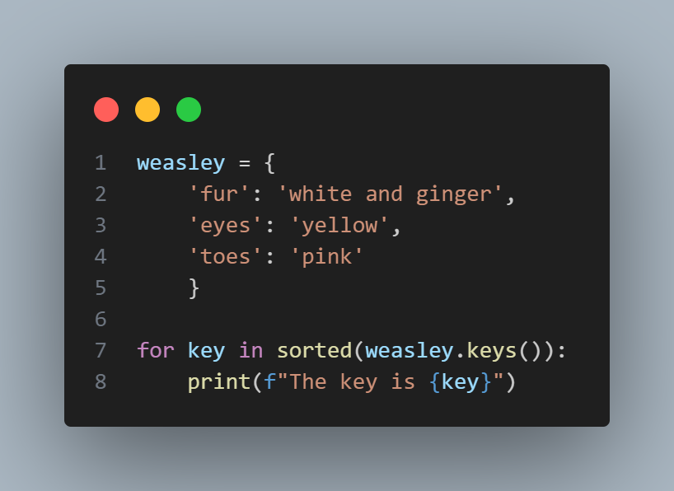
You can sort your dictionaries using sorted()
Remember to WRAP your sorted() around the DICTIONARY you want to sort!
Notes:
weasley = {
'fur': 'white and ginger',
'eyes': 'yellow',
'toes': 'pink'
}
for key in sorted(weasley.keys()):
print(f"The key is {key}")

Slide 19
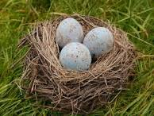
Nesting
You might want to store a list inside a dictionary, or a dictionary inside a list… This is called nesting.

Slide 20
A List of Dictionaries
Notes:
weasley = {
'fur': 'white and ginger',
'eyes': 'yellow',
'toes': 'pink'
}
noche = {
'fur': 'black',
'eyes': 'green',
'toes': 'black'
}
bigglesworth = {
'fur': 'none',
'eyes': 'brown',
'toes': 'multi'
}
cats = [weasley, noche, bigglesworth]
for cat in cats:
print(cat)

Slide 21
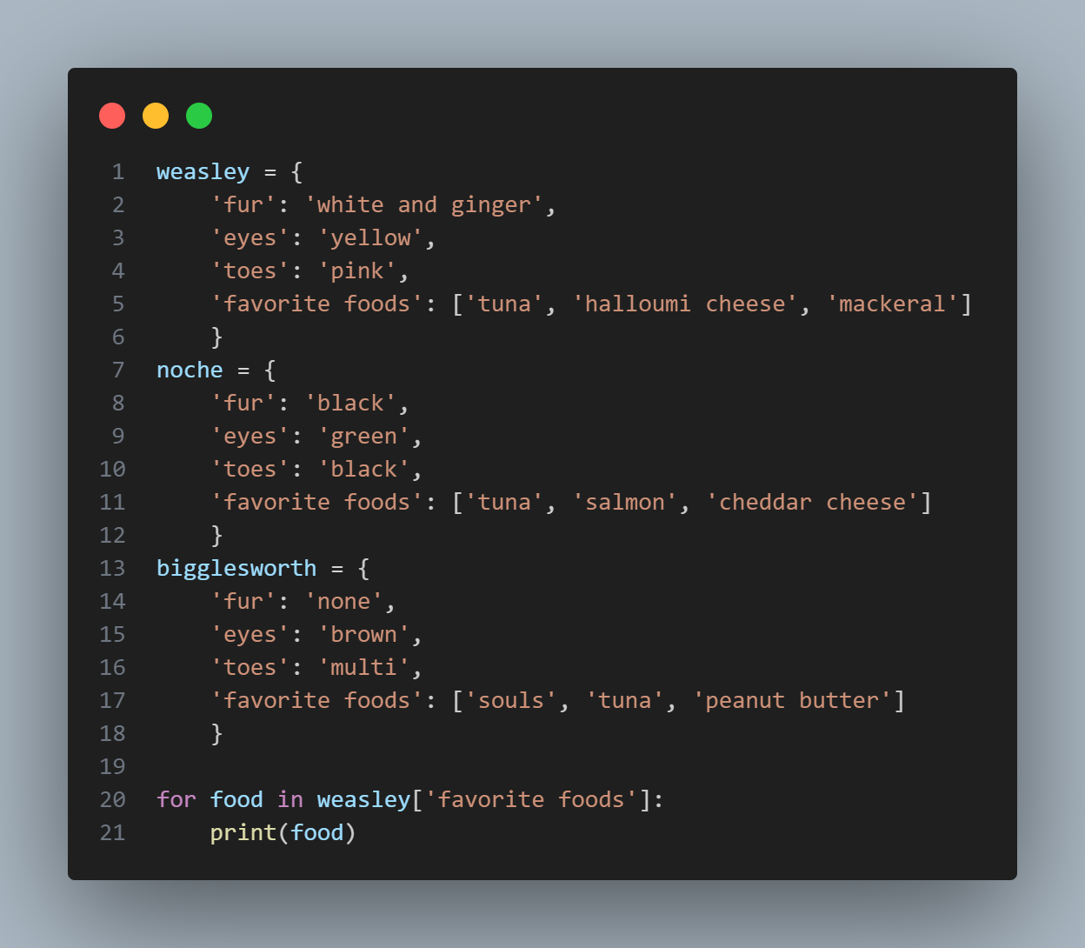
A List in a Dictionary
Notes:
weasley = {
'fur': 'white and ginger',
'eyes': 'yellow',
'toes': 'pink',
'favorite foods': ['tuna', 'halloumi cheese', 'mackeral']
}
noche = {
'fur': 'black',
'eyes': 'green',
'toes': 'black',
'favorite foods': ['tuna', 'salmon', 'cheddar cheese']
}
bigglesworth = {
'fur': 'none',
'eyes': 'brown',
'toes': 'multi',
'favorite foods': ['souls', 'tuna', 'peanut butter']
}
for food in weasley['favorite foods']:
print(food)

Slide 22
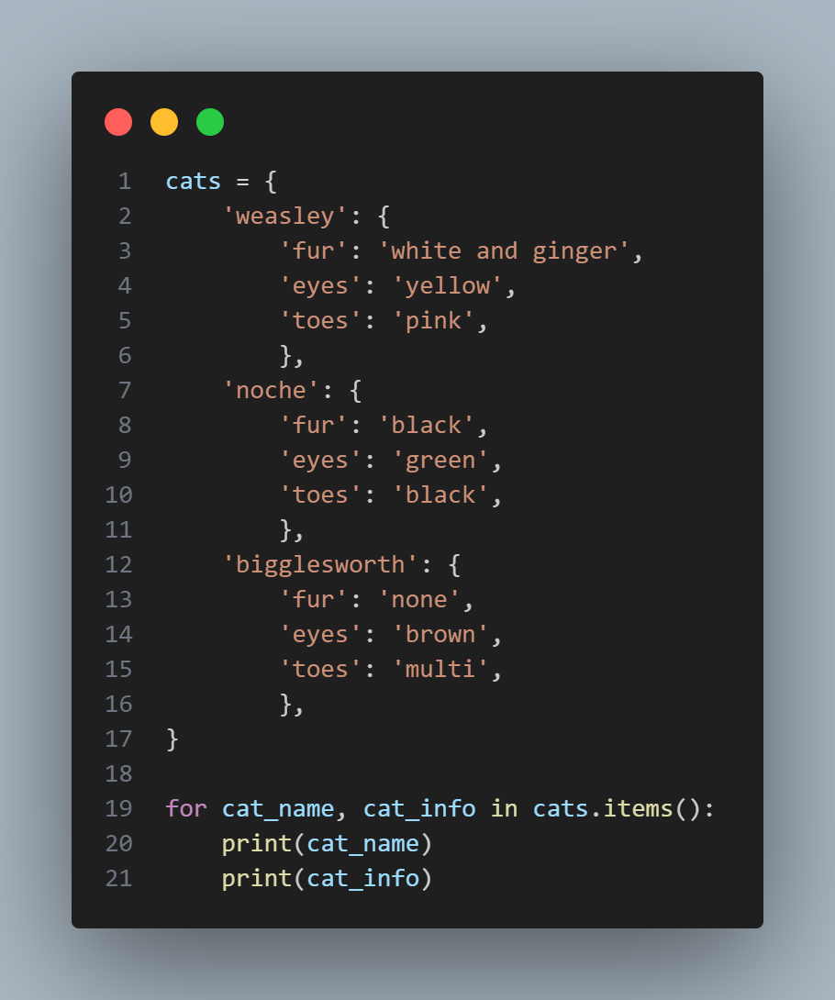
A Dictionary in a Dictionary
You can also have a dictionary within a dictionary… but things can get complicated if you do this! So be careful.
Notes:
cats = {
'weasley': {
'fur': 'white and ginger',
'eyes': 'yellow',
'toes': 'pink',
},
'noche': {
'fur': 'black',
'eyes': 'green',
'toes': 'black',
},
'bigglesworth': {
'fur': 'none',
'eyes': 'brown',
'toes': 'multi',
},
}
for cat_name, cat_info in cats.items():
print(cat_name)
print(cat_info)

Slide 23

Onwards to exercise 6!

